Slide 1
18ITT42 - DESIGN AND ANALYSIS OF ALGORITHMS
(IV-Semester)
Velalar College of Engineering and Technology
(Autonomous)
Department of CSE
(Accredited by NBA)
Handled By:
Dr.V.Latha Jothi , Professor

Slide 2
UNIT – II
Analysis of Sorting and Searching Algorithms
Brute Force – Selection Sort and Bubble Sort - Divide and conquer – Merge sort – Quick Sort-Strassen‟s Matrix Multiplication -Decrease and Conquer – Insertion Sort–Transform and Conquer-Heaps and Heap sort- Analysis of Linear Search and Binary search techniques

Slide 3
DECREASE AND CONQUER

Slide 4
DECREASE AND CONQUER
The decrease-and-conquer technique is based on exploiting the relationship between a solution to a given instance of a problem and a solution to its smaller instance.
Can be solved by top down or bottom up approach
There are three major variations of decrease-and-conquer:
  decrease by a constant
  decrease by a constant factor
  variable size decrease .

Slide 5

DECREASE AND CONQUER - decrease by a constant
the size of an instance is reduced by the same constant usually 1.
For example a^{n} = a * a^{n-1}
This can be written using top – down approach as
using bottom - up approach it can be written as
multiplying 1 by a, n times

Slide 6
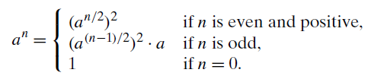
DECREASE AND CONQUER - decrease by a constant factor
reducing a problem instance by the same constant factor on each iteration of the algorithm, usually 2.
For example a^{n} = (a^{n/2})² if n is even
a^{n} = a * (a^{(n-1)/2})² if n is odd
Combining it can be written as

Slide 7
DECREASE AND CONQUER - variable-size-decrease
The size-reduction pattern varies from one iteration to another.
Eg: Euclid’s algorithm for computing the greatest common divisor
gcd(m, n) = gcd(n, m mod n)

Slide 8
Insertion Sort
Can be solved by decrease-by-one technique
similar to the way we sort playing cards
The array is virtually split into a sorted and an unsorted part. Values from the unsorted part are picked and placed at the correct position in the sorted part.
Insertion sort is efficient for small data values
Insertion sort is adaptive in nature, i.e. it is appropriate for data sets which are already partially sorted.

Slide 9
Insertion Sort
  12| 11 13 5 6
  11 12| 13 5 6
11 12 13| 5 6
  5 11 12 13| 6
  5 6 11 12 13

Slide 10
Insertion Sort
ALGORITHM InsertionSort(A[0..n − 1])
//Sorts a given array by insertion sort
//Input: An array A[0..n − 1] of n orderable elements
//Output: Array A[0..n − 1] sorted in nondecreasing order
for i ←1 to n − 1 do
    v ←A[i]
    j ←i − 1
    while j ≥ 0 and A[j ]> v do
      A[j + 1]←A[j ]
      j ←j − 1
    A[j + 1]←v

Slide 11

Analysis of Insertion Sort
The basic operation of the algorithm is the key comparison A[j ] > v.
In the worst case, A[j ]> v is executed the largest number of times, i.e., for every j = i − 1, . . . , 0. Since v = A[i], it happens if and only if A[j ]>A[i] for j = i − 1 , . . . , 0.
for the worst-case input, we get A[0] > A[1] (for i = 1), A[1]>A[2] (for i = 2), . . . , A[n − 2]>A[n − 1] (for i = n − 1)
The number of key comparisons for such an input is

Slide 12

Analysis of Insertion Sort
In the best case, the comparison A[j ]> v is executed only once on every iteration of the outer loop. It happens if and only if A[i − 1]≤ A[i] for every i = 1, . . . , n − 1, i.e., if the input array is already sorted in non-decreasing order.

Slide 13
BINARY SEARCH

Slide 14
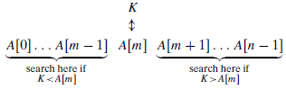
BINARY SEARCH
Can be solved using decrease by a constant factor variation of Decrease and Conquer algorithm design technique.
Binary search is a remarkably efficient algorithm for searching in a sorted array.
It works by comparing a search key K with the array’s middle element A[m]. If they match, the algorithm stops; otherwise, the same operation is repeated recursively for the first half of the array if K <A[m], and for the second half if K >A[m].

Slide 15

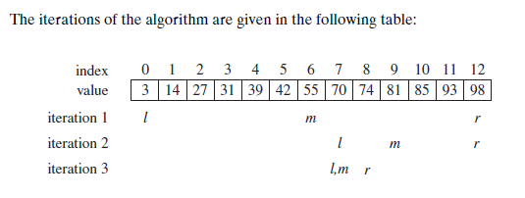
BINARY SEARCH
Eg: Search K = 70 in the given array

Slide 16
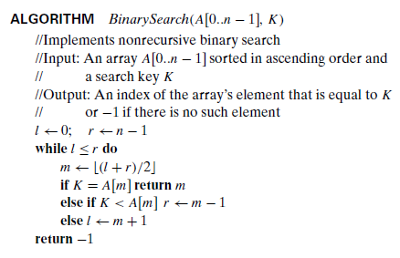
BINARY SEARCH

Slide 17
Analysis of Binary Search Algorithm
The algorithm’s basic operation is comparison.
Therefore the number of comparisons needed is
C_{worst}(n) = C_{worst}(n/2) + 1 for n > 1, C_{worst}(1) = 1 ---- 1
C_{worst}(n/2) = C_{worst}(n/4) + 1 ---- 2
Sub. 2 in 1,
C_{worst}(n) = C_{worst}(n/4) + 1 + 1
= C_{worst}(n/4) + 2
= C_{worst}(n/8) + 3 and so on
In general,
C_{worst}(n) = C_{worst}(n/2^{k}) + k
Let n = 2^{k}
C_{worst}(2^{k} ) = C_{worst}(2^{k} /2^{k}) + k = C_{worst}(1) + k = 1+k
But n = 2^{k}; k = log₂n
C_{worst}(n) = 1 + log₂n

Slide 18
BINARY SEARCH
The worst-case time efficiency of binary search is Θ(log n).
The average number of key comparisons made by binary search is only slightly smaller than that in the worst case: C_{avg}(n) ≈ log₂n.

Slide 19
THANK YOU

